Slide 1
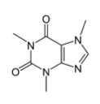
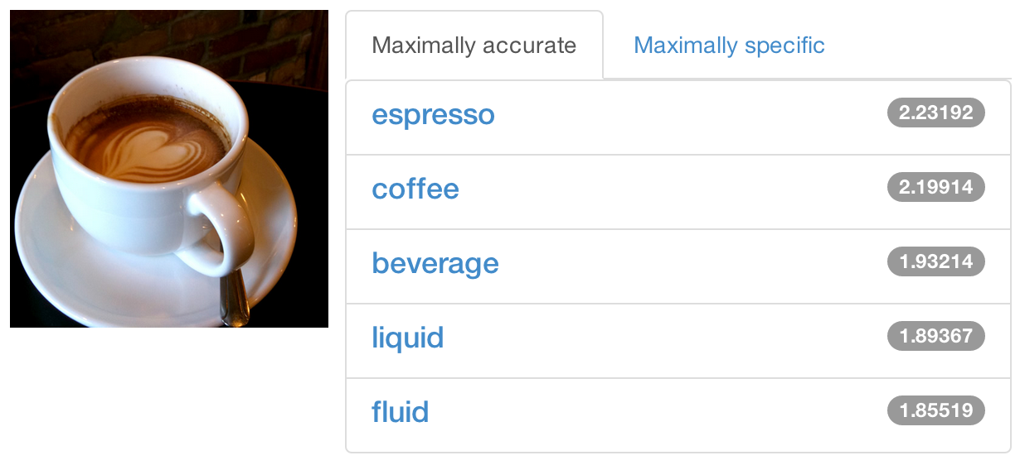



DIY Deep Learning for Vision:
a Hands-On Tutorial with Caffe
caffe.berkeleyvision.org
Evan Shelhamer, Jeff Donahue, Jonathan Long, Yangqing Jia, Ross Girshick
github.com/BVLC/caffe
Look for further details in the outline notes
Notes:
Outline notes coming soon.

Slide 2
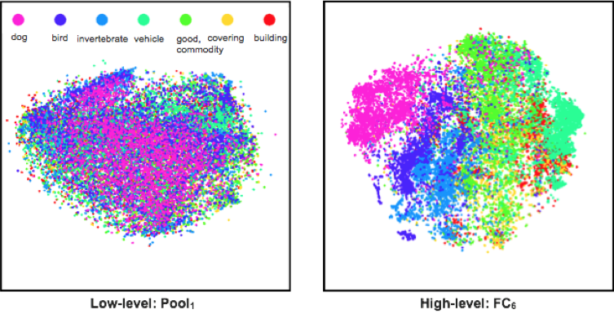
Why Deep Learning? The Unreasonable Effectiveness of Deep Features
Classes separate in the deep representations and transfer to many tasks. [DeCAF] [Zeiler-Fergus]

Slide 3
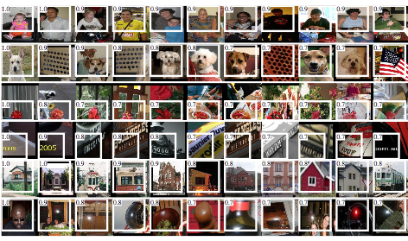
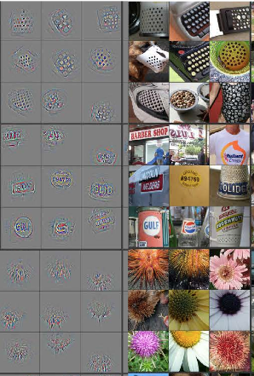
Why Deep Learning? The Unreasonable Effectiveness of Deep Features
Maximal activations of pool₅ units
[R-CNN]
conv₅ DeConv visualization
Rich visual structure of features deep in hierarchy.
[Zeiler-Fergus]

Slide 4
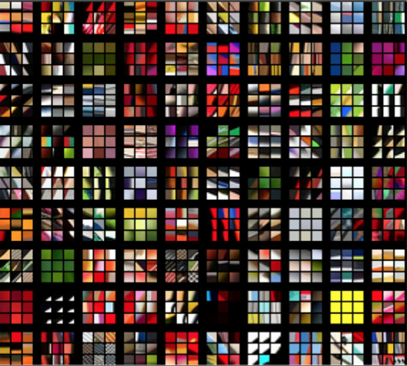
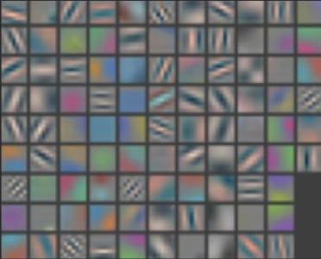
Why Deep Learning? The Unreasonable Effectiveness of Deep Features
1st layer filters
image patches that strongly activate 1st layer filters
[Zeiler-Fergus]

Slide 5
What is Deep Learning?
Compositional Models
Learned End-to-End

Slide 6
What is Deep Learning?
Compositional Models
Learned End-to-End
Hierarchy of Representations
vision: pixel, motif, part, object
text: character, word, clause, sentence
speech: audio, band, phone, word
concrete
abstract
learning

Slide 7
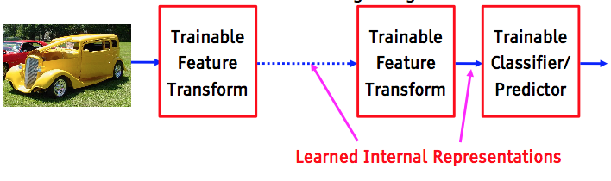
What is Deep Learning?
Compositional Models
Learned End-to-End
figure credit Yann LeCun, ICML ‘13 tutorial

Slide 8
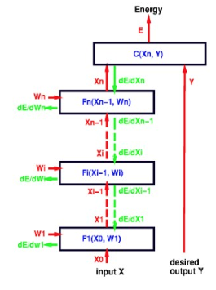
What is Deep Learning?
Compositional Models
Learned End-to-End
Back-propagation: take the gradient of the model layer-by-layer by the chain rule to yield the gradient of all the parameters.
figure credit Yann LeCun, ICML ‘13 tutorial

Slide 9
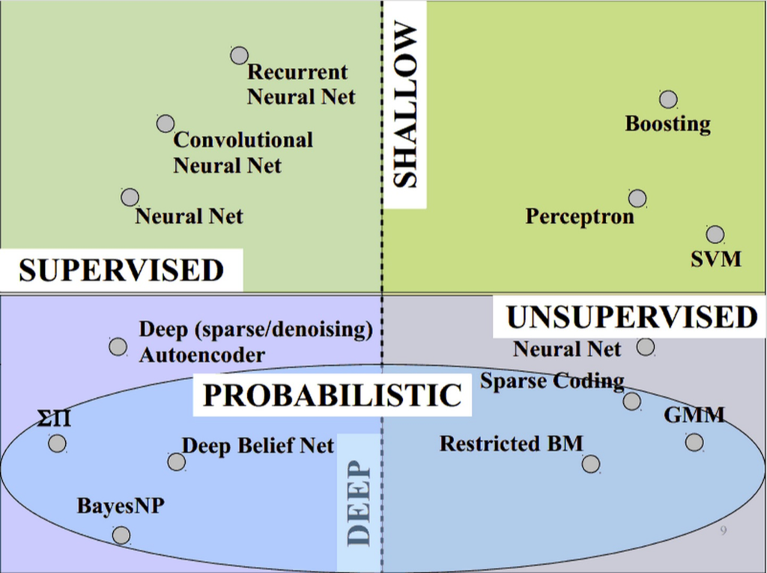
What is Deep Learning?
Vast space of models!
Caffe models are loss-driven:
supervised
unsupervised
slide credit Marc’aurelio Ranzato, CVPR ‘14 tutorial.

Slide 10
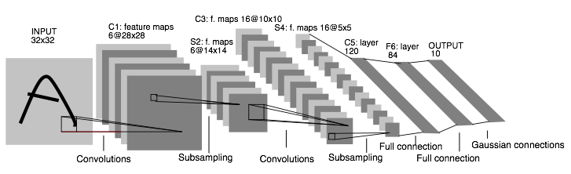
Convolutional Neural Nets (CNNs): 1989
LeNet: a layered model composed of convolution and subsampling operations followed by a holistic representation and ultimately a classifier for handwritten digits. [ LeNet ]

Slide 11
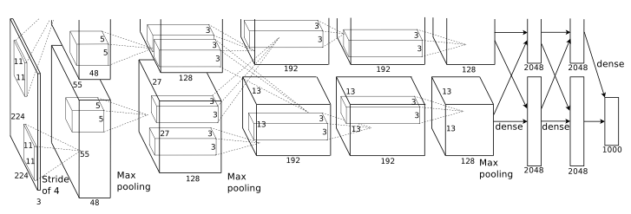
Convolutional Nets: 2012
AlexNet: a layered model composed of convolution, subsampling, and further operations followed by a holistic representation and all-in-all a landmark classifier on
ILSVRC12. [ AlexNet ]
+ data
+ gpu
+ non-saturating nonlinearity
+ regularization

Slide 12
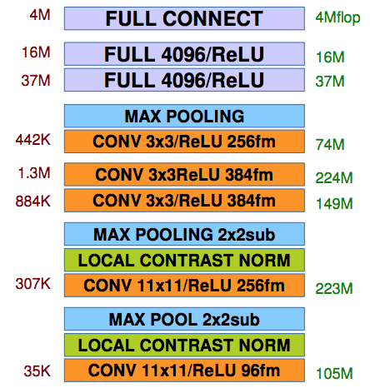
Convolutional Nets: 2012
AlexNet: a layered model composed of convolution, pooling, and further operations followed by a holistic representation and all-in-all a landmark classifier on
ILSVRC12. [ AlexNet ]
The fully-connected “FULL” layers are linear classifiers / matrix multiplications. ReLU are rectified-linear non-linearities on the output of layers.
parameters
FLOPs
figure credit Y. LeCun and M.A. Ranzato, ICML ‘13 tutorial

Slide 13
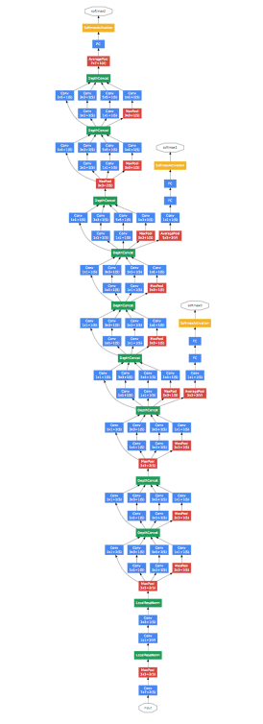
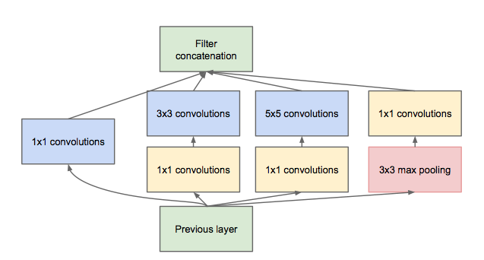
Convolutional Nets: 2014
ILSVRC14 Winners: ~6.6% Top-5 error
GoogLeNet: composition of multi-scale dimension-reduced modules (pictured)
VGG: 16 layers of 3x3 convolution interleaved with max pooling + 3 fully-connected layers
+ depth
+ data
+ dimensionality reduction

Slide 14
Learning about Deep Learning
Refer to the Tutorial on Deep Learning for Vision
from CVPR ‘14.
Fundamentals on supervised and unsupervised deep learning by Marc’Aurelio Ranzato
List of references to explore
Advanced ideas and current research directions
Pairs well with this tutorial!

Slide 15
Deep Learning, as it is executed...
What should a framework handle?
Compositional Models
Decompose the problem and code!
End-to-End Learning
Solve and check!
Vast Space of Architectures and Tasks
Define, experiment, and extend!

Slide 16
Frameworks
Torch7
NYU
scientific computing framework in Lua
supported by Facebook
Theano/Pylearn2
U. Montreal
scientific computing framework in Python
symbolic computation and automatic differentiation
Cuda-Convnet2
Alex Krizhevsky
Very fast on state-of-the-art GPUs with Multi-GPU parallelism
C++ / CUDA library

Slide 17
Framework Comparison
More alike than different
All express deep models
All are nicely open-source
All include scripting for hacking and prototyping
No strict winners – experiment and choose the framework that best fits your work
We like to brew our deep networks with Caffe

Slide 18
Why Caffe? In one sip…
Expression: models + optimizations are plaintext schemas, not code.
Speed: for state-of-the-art models and massive data.
Modularity: to extend to new tasks and settings.
Openness: common code and reference models for reproducibility.
Community: joint discussion and development through BSD-2 licensing.

Slide 19

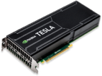
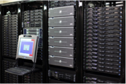
So what is Caffe?
Pure C++ / CUDA architecture for deep learning
command line, Python, MATLAB interfaces
Fast, well-tested code
Tools, reference models, demos, and recipes
Seamless switch between CPU and GPU
Caffe::set_mode(Caffe::GPU);
Prototype
Training
Deployment
All with essentially the same code!

Slide 20
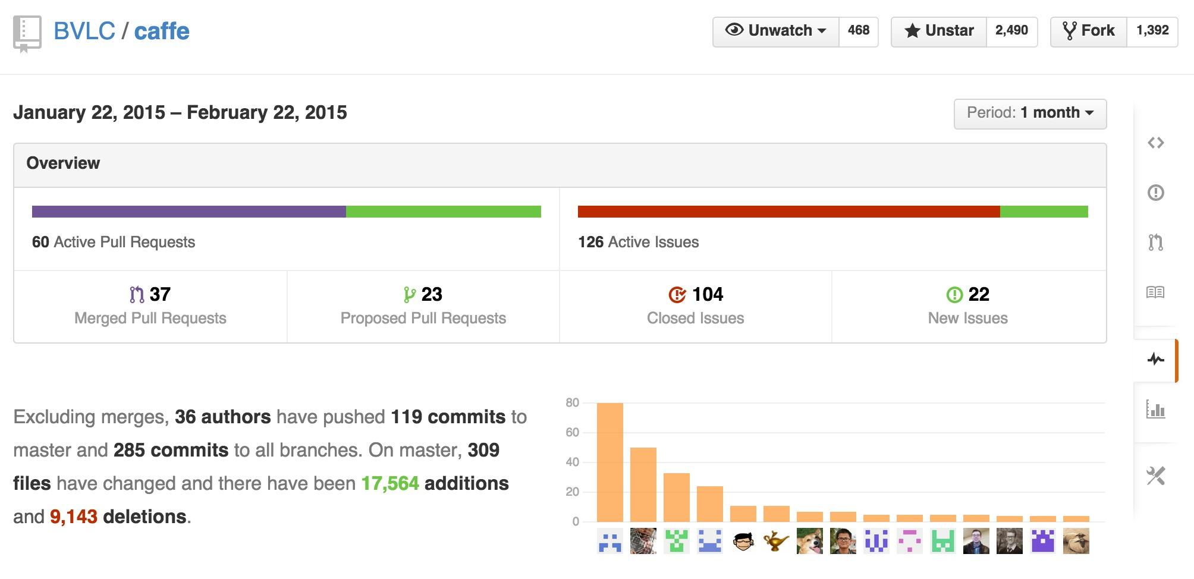
Caffe is a Community project pulse

Slide 21
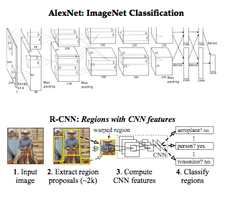
Reference Models
Caffe offers the
model definitions
optimization settings
pre-trained weights
so you can start right away.
The BVLC models are licensed for unrestricted use.

Slide 22
Open Model Collection
The Caffe Model Zoo
- open collection of deep models to share innovation
- VGG ILSVRC14 + Devil models in the zoo
- Network-in-Network / CCCP model in the zoo
- MIT Places scene recognition model in the zoo
- help disseminate and reproduce research
- bundled tools for loading and publishing models
Share Your Models! with your citation + license of course

Slide 23
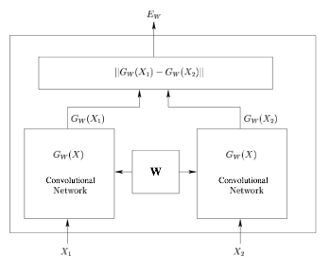
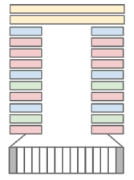
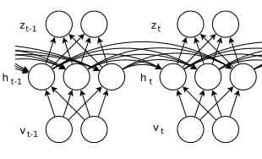
Architectures
DAGs
multi-input
multi-task
Weight Sharing
Recurrent (RNNs)
Sequences
Siamese Nets
Distances
[ Karpathy14 ]
[ Sutskever13 ]
[ Chopra05 ]
Define your own model from our catalogue of layers types and start learning.

Slide 24
Brewing by the Numbers...
Speed with Krizhevsky's 2012 model:
2 ms / image on K40 GPU
~1 ms inference with Caffe + cuDNN
60 million images / day
8-core CPU: ~20 ms/image
9k lines of C++ code (20k with tests)

Slide 25
CAFFE INTRO

Slide 26
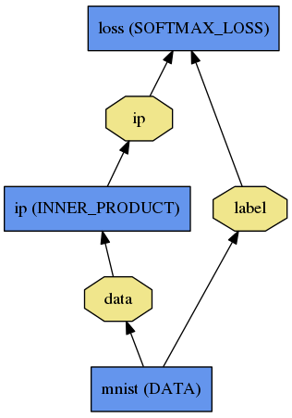
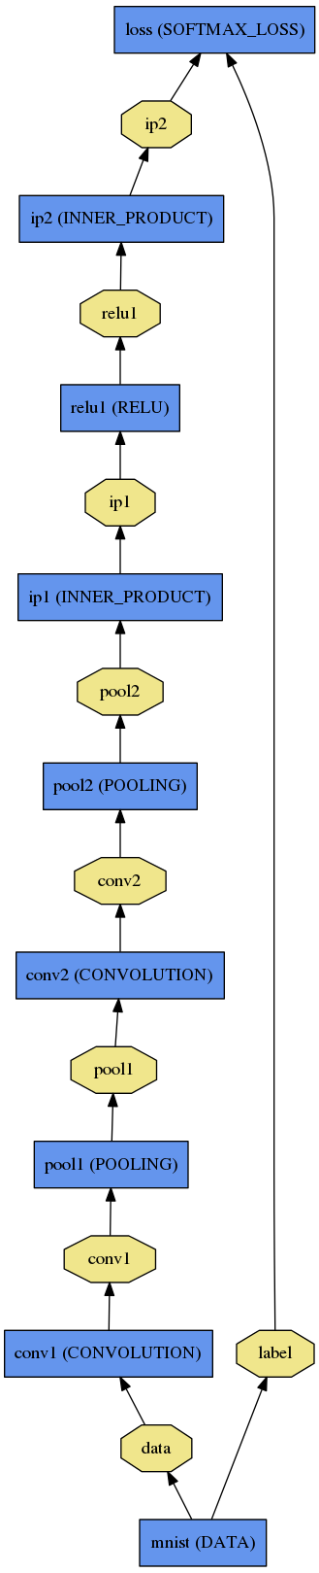
Net
A network is a set of layers connected as a DAG:
name: "dummy-net"
layers { name: "data" …}
layers { name: "conv" …}
layers { name: "pool" …}
… more layers …
layers { name: "loss" …}
LogReg ↑
Caffe creates and checks the net from the definition.
Data and derivatives flow through the net as blobs – a an array interface
LeNet →
ImageNet, Krizhevsky 2012 →

Slide 27
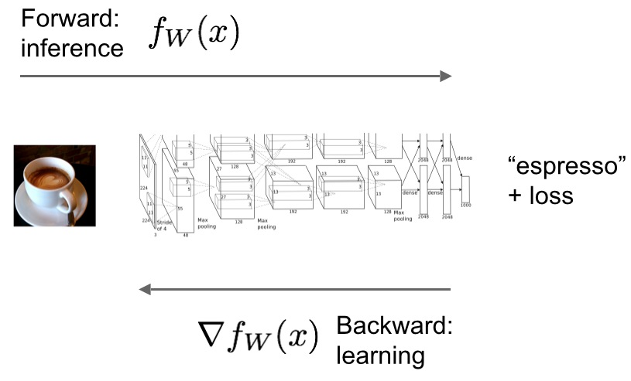
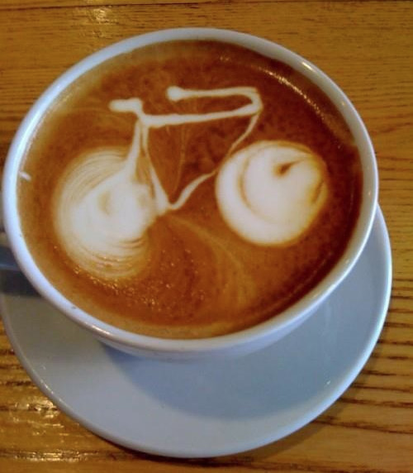
Forward / Backward the essential Net computations
Caffe models are complete machine learning systems for inference and learning.
The computation follows from the model definition. Define the model and run.

Slide 28
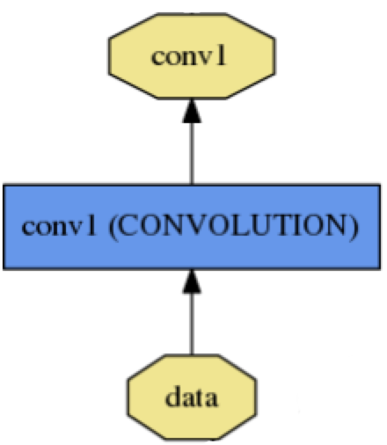
Layer
name: "conv1"
type: CONVOLUTION
bottom: "data"
top: "conv1"
convolution_param {
num_output: 20
kernel_size: 5
stride: 1
weight_filler {
type: "xavier"
}
}
name, type, and the connection structure
(input blobs and output blobs)
layer-specific parameters
- Setup
- Forward
- Backward
Every layer type defines
* Nets + Layers are defined by protobuf schema

Slide 29
Protobuf
name: "conv1"
type: "Convolution"
bottom: "data"
top: "conv1"
convolution_param {
num_output: 20
kernel_size: 5
stride: 1
weight_filler {
type: "xavier"
}
}
Nets + Layers are defined by protobuf schema
Net / Layer / Solver schema is defined by caffe.proto
Consult this definition for all the configuration options (inline comments explain it)

Slide 30
Layer Protocol
Setup: run once for initialization.
Forward: make output given input.
Backward: make gradient of output
- w.r.t. bottom
- w.r.t. parameters (if needed)
Compositional Modeling The Net’s forward and backward passes are composed of the layers’ steps.
Layer Development Checklist

Slide 31
Blob
name: "conv1"
type: CONVOLUTION
bottom: "data"
top: "conv1"
… definition …
Blobs are 4-D arrays for storing and communicating information.
hold data, derivatives, and parameters
lazily allocate memory
shuttle between CPU and GPU
top blob
Data
Number x K Channel x Height x Width
256 x 3 x 227 x 227 for ImageNet train input
Parameter: Convolution Weight
N Output x K Input x Height x Width
96 x 3 x 11 x 11 for CaffeNet conv1
Parameter: Convolution Bias
96 x 1 x 1 x 1 for CaffeNet conv1
bottom blob

Slide 32
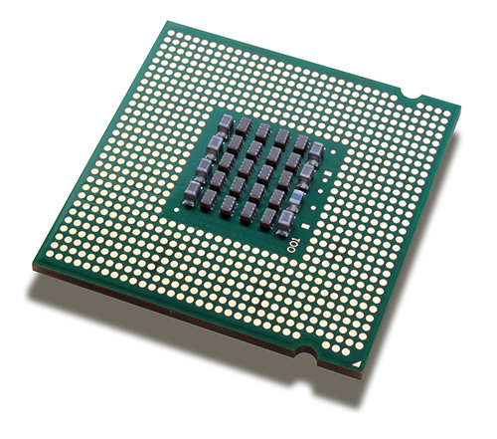
Blob
Blobs provide a unified memory interface.
Reshape(num, channel, height, width)
- declare dimensions
- make SyncedMem -- but only lazily allocate
cpu_data(), mutable_cpu_data()
- host memory for CPU mode
gpu_data(), mutable_gpu_data()
- device memory for GPU mode
SyncedMem
allocation + communication
{cpu,gpu}_diff(), mutable_{cpu,gpu}_diff()
- derivative counterparts to data methods
- easy access to data + diff in forward / backward

Slide 33
Solving: Training a Net
Optimization like model definition is configuration.
train_net: "lenet_train.prototxt"
base_lr: 0.01
momentum: 0.9
weight_decay: 0.0005
max_iter: 10000
snapshot_prefix: "lenet_snapshot"
All you need to run things on the GPU.
> caffe train -solver lenet_solver.prototxt -gpu 0
Stochastic Gradient Descent (SGD) + momentum ·
Adaptive Gradient (ADAGRAD) · Nesterov’s Accelerated Gradient (NAG)

Slide 34
Recipe for Brewing
Convert the data to Caffe-format
lmdb, leveldb, hdf5 / .mat, list of images, etc.
Define the Net
Configure the Solver
caffe train -solver solver.prototxt -gpu 0
Examples are your friends
caffe/examples/mnist,cifar10,imagenet
caffe/examples/*.ipynb
caffe/models/*

Slide 35
(Examples)
Logistic Regression
Learn LeNet on MNIST

Slide 36
Help Brewing
Documentation
tutorial documentation
worked examples
Modeling, Usage, and Installation
caffe-users group
gitter.im chat

Slide 37
EXAMPLES + APPLICATIONS

Slide 38
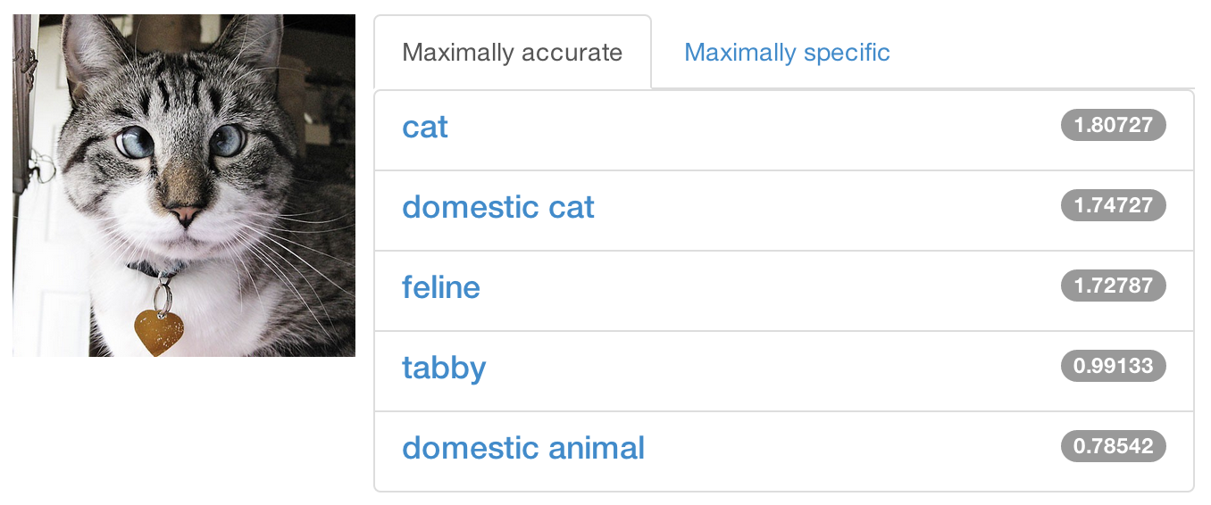
Share a Sip of Brewed Models
demo.caffe.berkeleyvision.org
demo code open-source and bundled

Slide 39
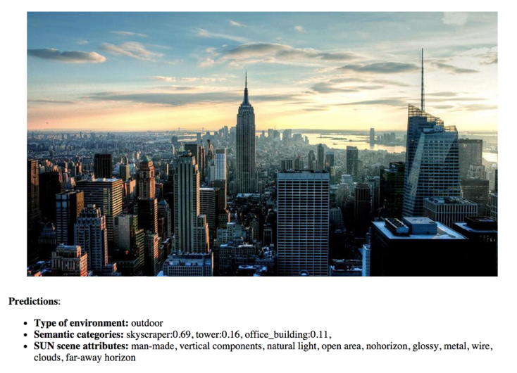
Scene Recognition http://places.csail.mit.edu/
B. Zhou et al. NIPS 14

Slide 40
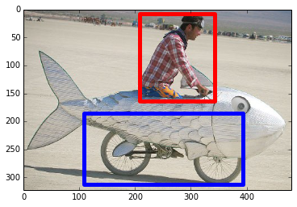
Object Detection
R-CNN: Regions with Convolutional Neural Networks
http://nbviewer.ipython.org/github/BVLC/caffe/blob/master/examples/detection.ipynb
Full R-CNN scripts available at
https://github.com/rbgirshick/rcnn
Ross Girshick et al.
Rich feature hierarchies for accurate object detection and semantic segmentation. CVPR14.

Slide 41
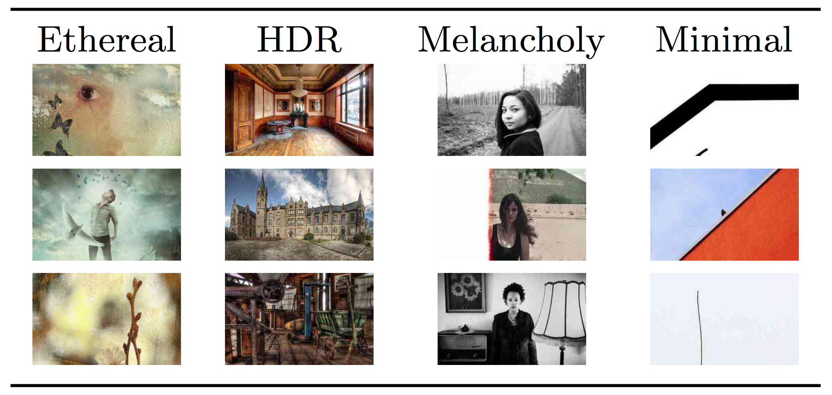
Visual Style Recognition
Karayev et al. Recognizing Image Style. BMVC14. Caffe fine-tuning example.
Demo online at http://demo.vislab.berkeleyvision.org/ (see Results Explorer).
Other Styles:
Vintage
Long Exposure
Noir
Pastel
Macro
… and so on.
[ Image-Style]

Slide 42
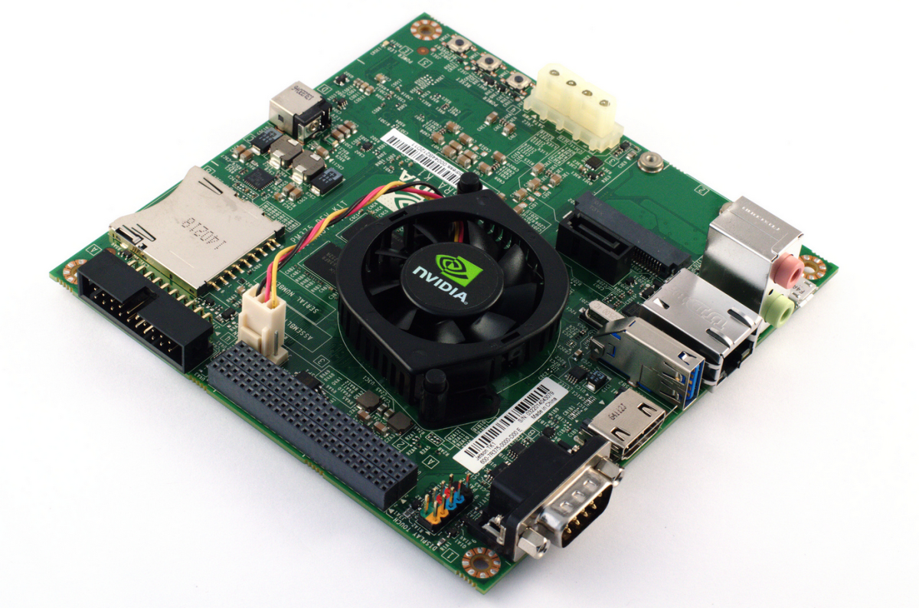
Embedded Caffe
Caffe on the NVIDIA Jetson TK1 mobile board
10 watts of power
inference at 35 ms per image
how-to guide courtesy of Pete Warden
cuDNN for TK1 recently released!

Slide 43
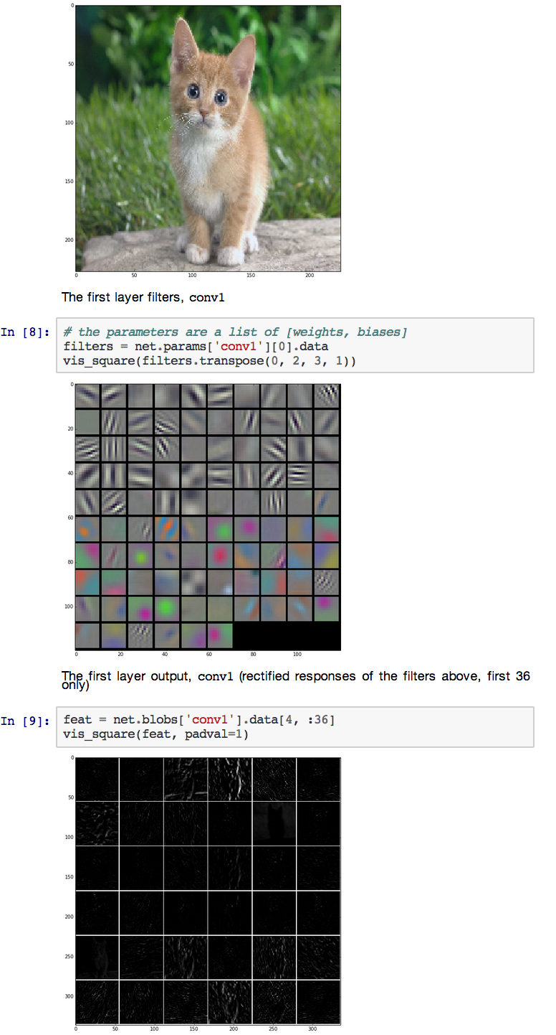
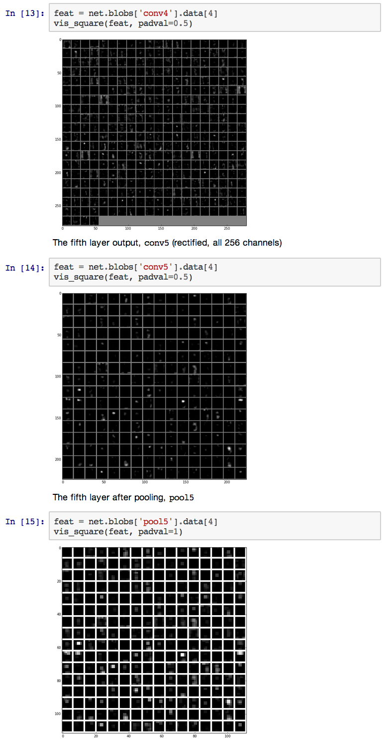
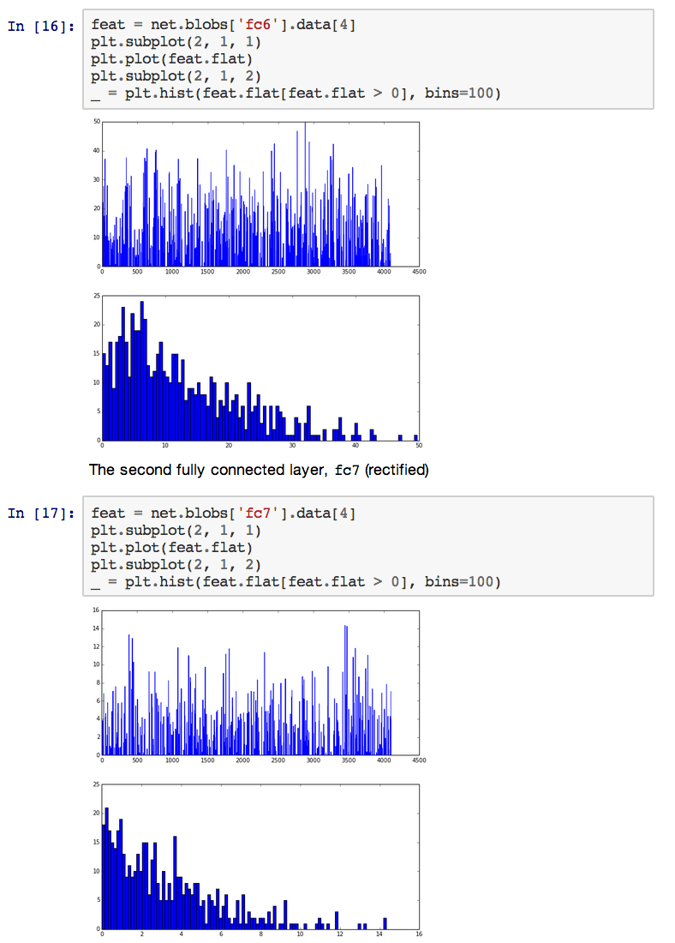
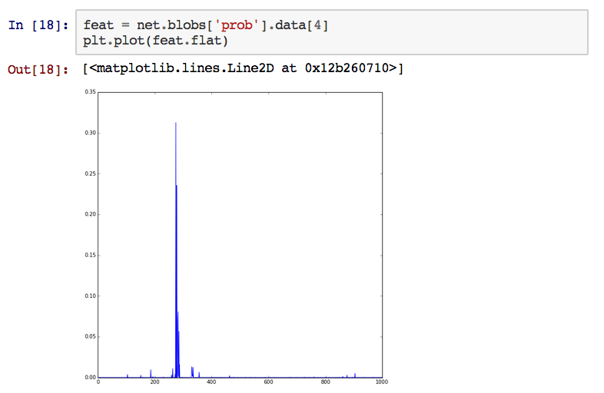
Feature Extraction + Visualization

Slide 44
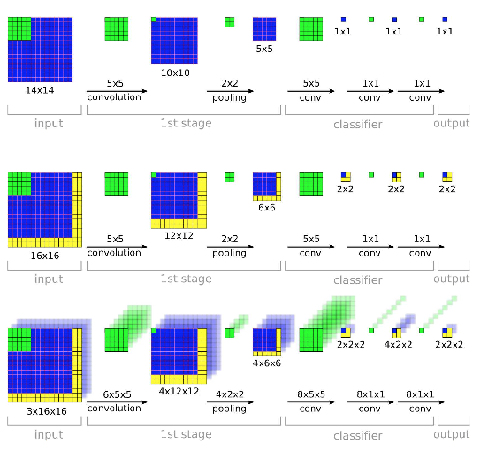
Editing Model Parameters
Transform fixed-input models into any-size models by translating inner products to convolutions.
The computation exploits a natural efficiency of convolutional neural network (CNN) structure by dynamic programming in the forward pass from shallow to deep layers and analogously in backward.
Net surgery in Caffe
how to transform models:
- make fully convolutional
- transplant parameters
[ OverFeat]

Slide 45
FINE-TUNING

Slide 46
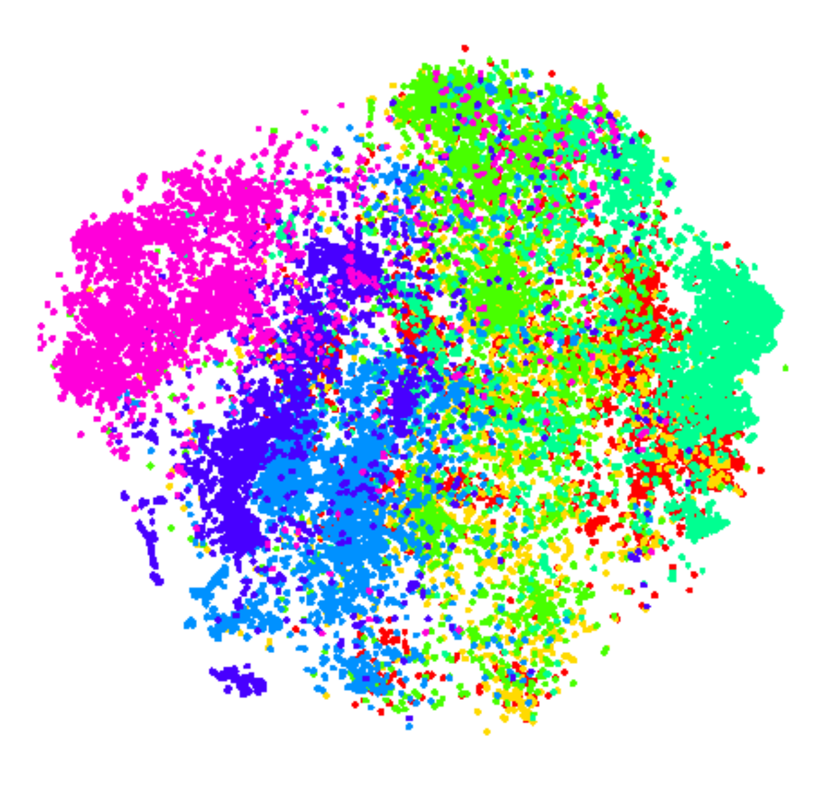
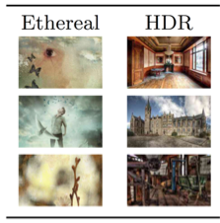
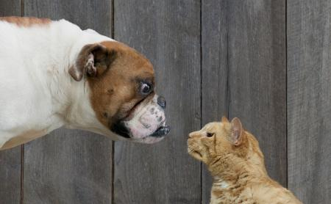
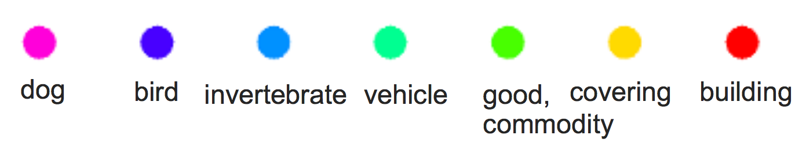
Fine-tuning Transferring learned weights to kick-start models
Take a pre-trained model and fine-tune to new tasks [DeCAF] [Zeiler-Fergus] [OverFeat]
Style
Recognition
Dogs vs.
Cats
top 10 in 10 minutes
Your Task
© kaggle.com

Slide 47
From ImageNet to Style
Simply change a few lines in the layer definition
layers { name: "data" type: DATA
data_param {
source: "ilsvrc12_train_leveldb"
mean_file: "../../data/ilsvrc12"
...
}
...
}
...
layers { name: "fc8" type: INNER_PRODUCT blobs_lr: 1 blobs_lr: 2
weight_decay: 1 weight_decay: 0
inner_product_param {
num_output: 1000
...
}
}
layers { name: "data" type: DATA
data_param {
source: "style_leveldb"
mean_file: "../../data/ilsvrc12"
...
}
...
}
...
layers { name: "fc8-style" type: INNER_PRODUCT blobs_lr: 1 blobs_lr: 2
weight_decay: 1 weight_decay: 0
inner_product_param {
num_output: 20
...
}
}
Input:
A different source
new name = new params
Last Layer:
A different classifier

Slide 48
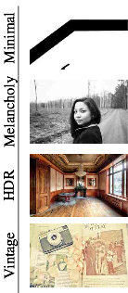
From ImageNet to Style
> caffe train -solver models/finetune_flickr_style/solver.prototxt
-weights bvlc_reference_caffenet.caffemodel
Step-by-step in pycaffe:
pretrained_net = caffe.Net(
"net.prototxt", "net.caffemodel")
solver = caffe.SGDSolver("solver.prototxt")
solver.net.copy_from(pretrained_net)
solver.solve()

Slide 49
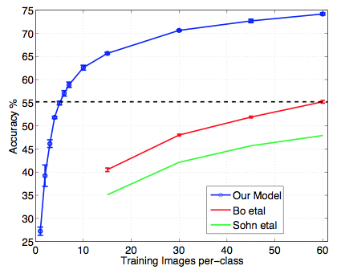
When to Fine-tune?
A good first step
More robust optimization – good initialization helps
Needs less data
Faster learning
State-of-the-art results in
recognition
detection
segmentation
[Zeiler-Fergus]

Slide 50
Fine-tuning Tricks
Learn the last layer first
Caffe layers have local learning rates: param { lr_mult: 1 }
Freeze all but the last layer for fast optimization and avoiding early divergence.
Stop if good enough, or keep fine-tuning
Reduce the learning rate
Drop the solver learning rate by 10x, 100x
Preserve the initialization from pre-training and avoid thrashing
Do net surgery

Slide 51
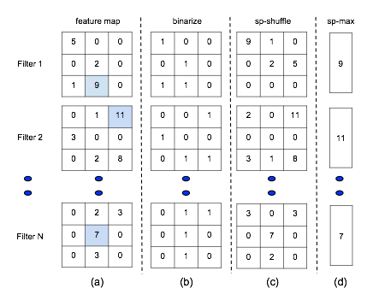
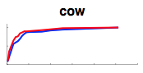
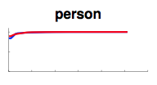
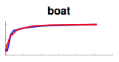
Training & Fine-tuning Analysis
Supervised pre-training does not overfit
Representation is (mostly) distributed
Sparsity comes “for free” in deep representation
P. Agarwal et al. ECCV 14

Slide 52
(Example)
Fine-tuning from ImageNet to Style

Slide 53
LOSS

Slide 54
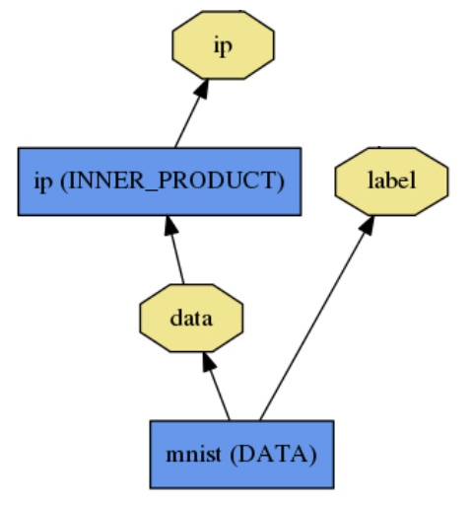
Loss
What kind of model is this?

Slide 55
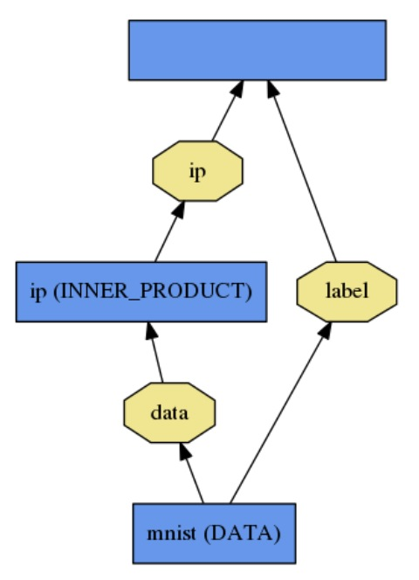
Loss
loss (LOSS_TYPE)
Classification
SOFTMAX_LOSS
HINGE_LOSS
Linear Regression
EUCLIDEAN_LOSS
Attributes / Multiclassification
SIGMOID_CROSS_ENTROPY_LOSS
Others…
New Task
NEW_LOSS
What kind of model is this?
Who knows! Need a loss function.

Slide 56

Loss
Loss function determines the learning task.
Given data D, a Net typically minimizes:
Data term: error averaged over instances
Regularization term: penalize large weights to improve generalization

Slide 57

Loss
The data error term is computed by Net::Forward
Loss is computed as the output of Layers
Pick the loss to suit the task – many different losses for different needs

Slide 58


Softmax Loss Layer
Multinomial logistic regression: used for predicting a single class of K mutually exclusive classes
layers { name: "loss" type: SOFTMAX_LOSS bottom: "pred" bottom: "label" top: "loss" }

Slide 59


Sigmoid Cross-Entropy Loss
Binary logistic regression: used for predicting K independent probability values in [0, 1]
layers { name: "loss" type: SIGMOID_CROSS_ENTROPY_LOSS bottom: "pred" bottom: "label" top: "loss" }

Slide 60

Euclidean Loss
A loss for regressing to real-valued labels [-inf, inf]
layers { name: "loss" type: EUCLIDEAN_LOSS bottom: "pred" bottom: "label" top: "loss" }

Slide 61

Multiple loss layers
Your network can contain as many loss functions as you want
Reconstruction and Classification:
layers { name: "recon-loss" type: EUCLIDEAN_LOSS bottom: "reconstructions" bottom: "data" top: "recon-loss" }
layers { name: "class-loss" type: SOFTMAX_LOSS bottom: "class-preds" bottom: "class-labels" top: "class-loss" }

Slide 62
Multiple loss layers
“*_LOSS” layers have a default loss weight of 1
layers { name: "loss" type: SOFTMAX_LOSS bottom: "pred" bottom: "label" top: "loss" }
layers { name: "loss" type: SOFTMAX_LOSS bottom: "pred" bottom: "label" top: "loss" loss_weight: 1.0 }
==

Slide 63
Multiple loss layers
Give each loss its own weight
E.g. give higher priority to classification error
layers { name: "recon-loss" type: EUCLIDEAN_LOSS bottom: "reconstructions" bottom: "data" top: "recon-loss" }
layers { name: "class-loss" type: SOFTMAX_LOSS bottom: "class-preds" bottom: "class-labels" top: "class-loss" loss_weight: 100.0 }
100*

Slide 64
Any layer can produce a loss!
Just add loss_weight: 1.0 to have a layer’s output be incorporated into the loss
E = || pred - label ||^2 / (2N)
diff = pred - label
layers { name: "loss" type: POWER bottom: "diff" top: "euclidean_loss"
power_param {
power: 2
}
# = 1/(2N)
loss_weight: 0.0078125 }
E = || diff ||^2 / (2N)
layers { name: "diff" type: ELTWISE bottom: "pred" bottom: "label" top: "diff"
eltwise_param {
op: SUM
coeff: 1
coeff: -1
}
}
layers { name: "loss" type: EUCLIDEAN_LOSS bottom: "pred" bottom: "label" top: "euclidean_loss"
loss_weight: 1.0 }
==
+

Slide 65
SOLVER

Slide 66
Solver
Solver optimizes the network weights W to minimize the loss L(W) over the data D
Coordinates forward / backward, weight updates, and scoring.

Slide 67




Solver
Computes parameter update , formed from
The stochastic error gradient
The regularization gradient
Particulars to each solving method

Slide 68

SGD Solver
Stochastic gradient descent, with momentum
solver_type: SGD

Slide 69
SGD Solver
“AlexNet” [1] training strategy:
Use momentum 0.9
Initialize learning rate at 0.01
Periodically drop learning rate by a factor of 10
Just a few lines of Caffe solver specification:
base_lr: 0.01 lr_policy: "step"
gamma: 0.1 stepsize: 100000 max_iter: 350000
momentum: 0.9
[1] A. Krizhevsky, I. Sutskever, and G. Hinton. ImageNet Classification with Deep Convolutional Neural Networks. Advances in Neural Information Processing Systems, 2012.

Slide 70


NAG Solver
Nesterov’s accelerated gradient [1]
solver_type: NESTEROV
Proven to have optimal convergence rate for convex problems
[1] Y. Nesterov. A Method of Solving a Convex Programming Problem with Convergence Rate (1/sqrt(k)). Soviet Mathematics Doklady, 1983.

Slide 71

AdaGrad Solver
Adaptive gradient (Duchi et al. [1])
solver_type: ADAGRAD
Attempts to automatically scale gradients based on historical gradients
[1] J. Duchi, E. Hazan, and Y. Singer. Adaptive Subgradient Methods for Online Learning and Stochastic Optimization. The Journal of Machine Learning Research, 2011.

Slide 72
Solver Showdown: MNIST Autoencoder
AdaGrad
SGD
Nesterov
I0901 13:36:30.007884 24952 solver.cpp:232] Iteration 65000, loss = 64.1627 I0901 13:36:30.007922 24952 solver.cpp:251] Iteration 65000, Testing net (#0) # train set I0901 13:36:33.019305 24952 solver.cpp:289] Test loss: 63.217 I0901 13:36:33.019356 24952 solver.cpp:302] Test net output #0: cross_entropy_loss = 63.217 (* 1 = 63.217 loss) I0901 13:36:33.019773 24952 solver.cpp:302] Test net output #1: l2_error = 2.40951
I0901 13:35:20.426187 20072 solver.cpp:232] Iteration 65000, loss = 61.5498 I0901 13:35:20.426218 20072 solver.cpp:251] Iteration 65000, Testing net (#0) # train set I0901 13:35:22.780092 20072 solver.cpp:289] Test loss: 60.8301 I0901 13:35:22.780138 20072 solver.cpp:302] Test net output #0: cross_entropy_loss = 60.8301 (* 1 = 60.8301 loss) I0901 13:35:22.780146 20072 solver.cpp:302] Test net output #1: l2_error = 2.02321
I0901 13:36:52.466069 22488 solver.cpp:232] Iteration 65000, loss = 59.9389 I0901 13:36:52.466099 22488 solver.cpp:251] Iteration 65000, Testing net (#0) # train set I0901 13:36:55.068370 22488 solver.cpp:289] Test loss: 59.3663 I0901 13:36:55.068410 22488 solver.cpp:302] Test net output #0: cross_entropy_loss = 59.3663 (* 1 = 59.3663 loss) I0901 13:36:55.068418 22488 solver.cpp:302] Test net output #1: l2_error = 1.79998

Slide 73


DAG
SDS two-stream net
Many current deep models
have linear structure
GoogLeNet Inception Module
but Caffe nets can have any directed acyclic graph (DAG) structure.
Define bottoms and tops and Caffe will connect the net.
LRCN joint vision-sequence model

Slide 74
WEIGHT SHARING

Slide 75
Weight sharing
Parameters can be shared and reused across Layers throughout the Net
Applications:
Convolution at multiple scales / pyramids
Recurrent Neural Networks (RNNs)
Siamese nets for distance learning

Slide 76
Weight sharing
Just give the parameter blobs explicit names using the param field
Layers specifying the same param name will share that parameter, accumulating gradients accordingly
layers: {
name: 'innerproduct1'
type: INNER_PRODUCT
inner_product_param {
num_output: 10
bias_term: false
weight_filler {
type: 'gaussian'
std: 10
}
}
param: 'sharedweights'
bottom: 'data'
top: 'innerproduct1'
}
layers: {
name: 'innerproduct2'
type: INNER_PRODUCT
inner_product_param {
num_output: 10
bias_term: false
}
param: 'sharedweights'
bottom: 'data'
top: 'innerproduct2'
}

Slide 77
RECENT MODELS
Network-in-Network (NIN)
GoogLeNet
VGG

Slide 78

Network-in-Network
filter with a nonlinear composition instead of a linear filter
1x1 convolution + nonlinearity
reduce dimensionality, deepen the representation
Linear Filter
CONV
NIN / MLP filter
1x1 CONV

Slide 79
GoogLeNet
composition of multi-scale dimension-reduced “Inception” modules
1x1 conv for dimensionality reduction
concatenation across filter scales
multiple losses for training to depth
“Inception” module

Slide 80

VGG
3x3 convolution all the way down...
fine-tuned progression of deeper models
16 and 19 parameter layer variations in the model zoo

Slide 81
NOW ROASTING
Parallelism
Pythonification done in rc2
Fully Convolutional Networks PRs open
Sequences PRs open
cuDNN v2 PR #1731
Gradient Accumulation PR #2016
More
FFT convolution
locally-connected layer
...

Slide 82
Parallelism
Parallel / distributed training across GPUs, CPUs, and cluster nodes
- collaboration with Flickr + open source community
- promoted to official integration branch in PR #1148
- faster learning and scaling to larger data

Slide 83
Pythonification done in #1703
Python Layer
layer prototyping and ease of expression
call Python from C++, C++ from Python, and around we go
Complete instrumentation in Python
data preparation
solving
inference
model definition still to come in #1733
Jon Long

Slide 84


Fully Convolutional Network: FCN
Model family for pixel prediction by conv. net
applied to semantic segmentation
end-to-end learning
efficiency in inference and learning 175 ms per-image prediction
multi-modal, multi-task
Further applications
depth estimation
denoising
arXiv and pre-release
Jon Long & Evan Shelhamer

Slide 85

Sequences
Recurrent Net RNN and Long Short Term Memory LSTM are sequential models
video
language
dynamics
learned by back-propagation through time.
LRCN: Long-term Recurrent Convolutional Network
activity recognition
image captioning
video captioning
arXiv and web page & PR
Jeff Donahue et al.

Slide 86


Slide 87
Gradient Accumulation #2016
decouple computational and learning mini-batch size
tune optimization independently of resource constraints
conserve memory
...and share convolution buffers for further memory savings.
Jon Long & Sergio Guadarrama

Slide 88








Thanks to the Caffe crew
Yangqing Jia, Evan Shelhamer, Jeff Donahue, Sergey Karayev
Jonathan Long, Ross Girshick, Sergio Guadarrama, Trevor Darrell
and our open source contributors!
...plus the cold-brew

Slide 89









Acknowledgements
Thank you to the Berkeley Vision and Learning Center Sponsors.
Thank you to NVIDIA
for GPU donation and
collaboration on cuDNN.
Thank you to our 75+
open source contributors
and vibrant community.
Thank you to A9 and AWS
for a research grant for Caffe dev and reproducible research.

Slide 90
References
[ DeCAF ] J. Donahue, Y. Jia, O. Vinyals, J. Hoffman, N. Zhang, E. Tzeng, and T. Darrell. Decaf: A deep convolutional activation feature for generic visual recognition. ICML, 2014.
[ R-CNN ] R. Girshick, J. Donahue, T. Darrell, and J. Malik. Rich feature hierarchies for accurate object detection and semantic segmentation. CVPR, 2014.
[ Zeiler-Fergus ] M. Zeiler and R. Fergus. Visualizing and understanding convolutional networks. ECCV, 2014.
[ LeNet ] Y. LeCun, L. Bottou, Y. Bengio, and P. Haffner. Gradient-based learning applied to document recognition. IEEE, 1998.
[ AlexNet ] A. Krizhevsky, I. Sutskever, and G. Hinton. Imagenet classification with deep convolutional neural networks. NIPS, 2012.
[ OverFeat ] P. Sermanet, D. Eigen, X. Zhang, M. Mathieu, R. Fergus, and Y. LeCun. Overfeat: Integrated recognition, localization and detection using convolutional networks. ICLR, 2014.
[ Image-Style ] S. Karayev, M. Trentacoste, H. Han, A. Agarwala, T. Darrell, A. Hertzmann, H. Winnemoeller. Recognizing Image Style. BMVC, 2014.
[ Karpathy14 ] A. Karpathy, G. Toderici, S. Shetty, T. Leung, R. Sukthankar, and L. Fei-Fei. Large-scale video classification with convolutional neural networks. CVPR, 2014.
[ Sutskever13 ] I. Sutskever. Training Recurrent Neural Networks. PhD thesis, University of Toronto, 2013.
[ Chopra05 ] S. Chopra, R. Hadsell, and Y. LeCun. Learning a similarity metric discriminatively, with application to face verification. CVPR, 2005.

